Slide 1
Probability
EQ – How do I calculate probabilities of combined events using two-way tables?
Mrs James
Year 10

Slide 2
Lesson objective
By the end of this lesson you will be able to;
Use 2-way tables to calculate probabilities
Use 2-way tables to calculate probabilities in situations involving replacement and where there is no replacement
B grade and above: you will be able to construct and use 2-way tables to calculate probabilities in situations involving replacement and where there is no replacement
Notes:
Lesson

Slide 3
24
7
30
Date
Probability
EQ: How do I calculate probabilities of combined events using two-way tables?
When an experiment involves 2 or more components, such as flipping a coin twice, we are dealing with combined events.
The outcome for such an event depends on whether or not they are conducted with or without replacement.
What this means is:
if replacement is allowed, then the outcomes from each selection can be repeated
If selections are made without replacement, then the outcomes from each selection cannot be repeated
It makes a big difference whether selections are replaced or not… take a look
https://www.youtube.com/watch?v=uKTjh-6PFjo at times it is like a relaxation tape……. Sorry!
Notes:
Input

Slide 4
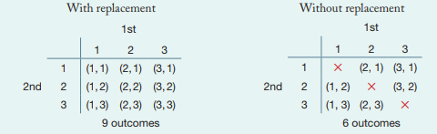
Example 1:
You have 3 sets of cards labelled: 1, 2 and 3. Two selections are made each time.
Here are the two-way tables showing the outcomes when the card is replaced each time versus when there is no replacement

Slide 5
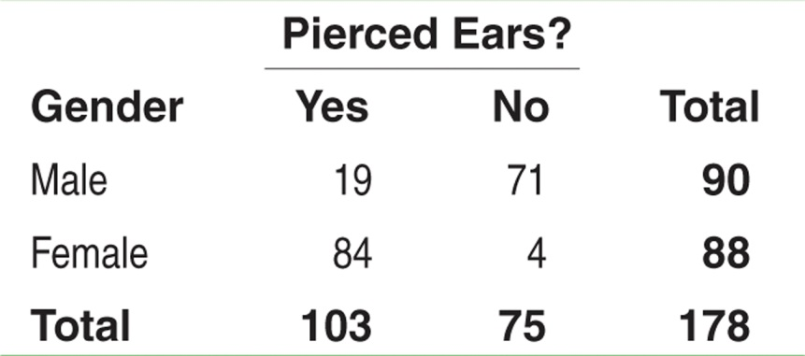
Example 2: We will do this together
Consider the following table. Suppose we choose a student at random. Find the probability that the student
has pierced ears.
is a male with pierced ears.
is a male or has pierced ears.
(a) Each student is equally likely to be chosen. 103 students have pierced ears. So, P(pierced ears) = P(B) = 103/178.
(b) We want to find P(male and pierced ears), that is, P(A and B). Look at the intersection of the “Male” row and “Yes” column. There are 19 males with pierced ears. So, P(A and B) = 19/178.
(c) We want to find P(male or pierced ears), that is, P(A or B). There are 90 males in the class and 103 individuals with pierced ears. However, 19 males have pierced ears – don’t count them twice!
P(A or B) = (19 + 71 + 84)/178. So, P(A or B) = 174/178
Notes:
Input

Slide 6
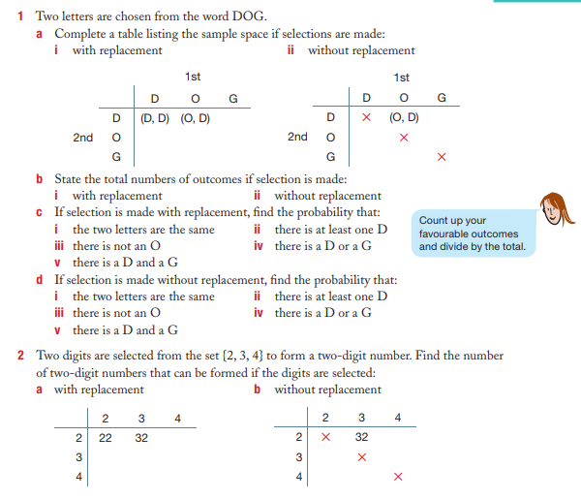
Your turn: Complete this in your Interactive notebook
Using two-way tables to calculate probabilities in situations that involves replacement and no replacement

Slide 7
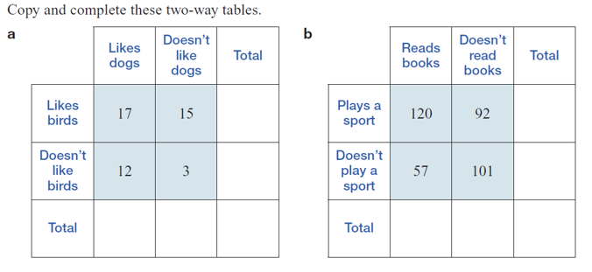
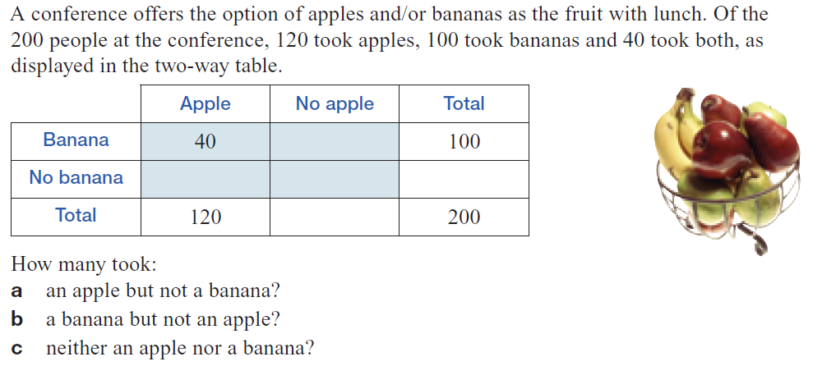
Your turn: Complete this in your Interactive notebook
Using two-way tables to calculate probabilities
3.
4.
Notes:
Guided practice

Slide 8
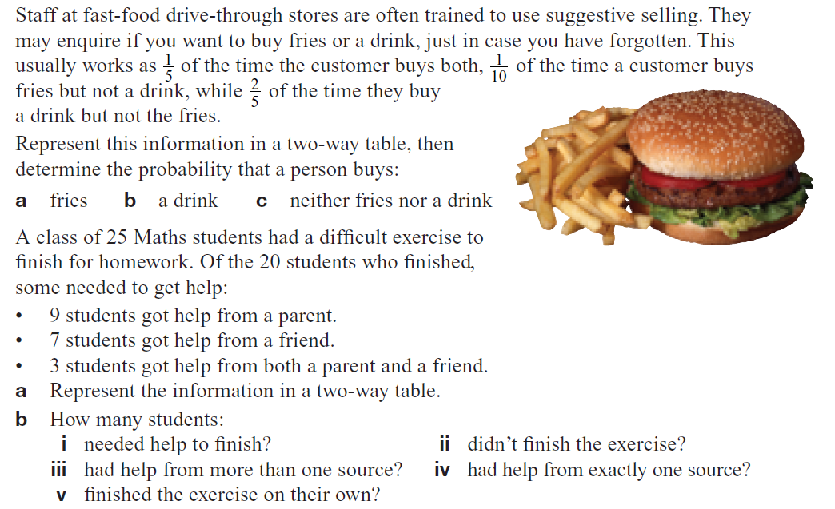
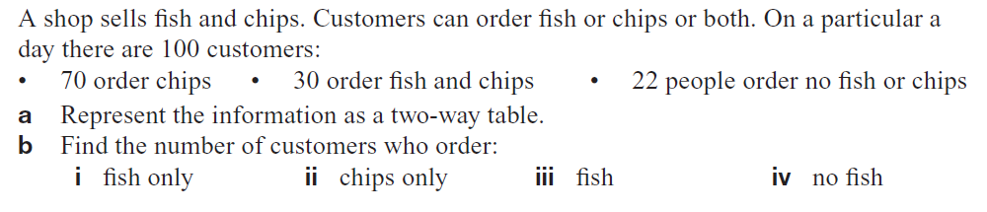
5.
6.
7.

Slide 9
Your turn to practice
This PowerPoint will be on CONNECT to support your revision and study of this topic.
Homework/Revision
Finish off the 7 Questions in this PowerPoint
Write your summary of this topic
Those that want to go further check out the next set of slides

Slide 10
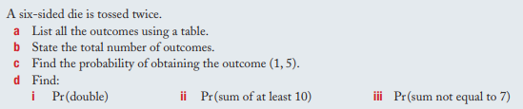
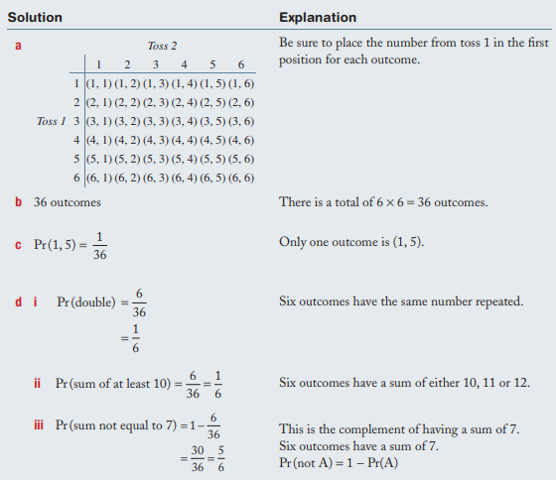
Example 3: Constructing a table with replacement
B-Grade
Not: Pr in this case is the same as P. Both are shorthand for “probability”
Notes:
Guided practice

Slide 11
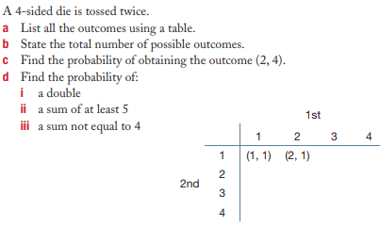
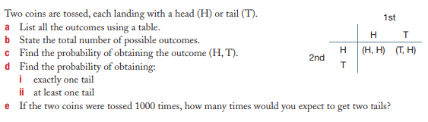
Your turn: Complete this in your Interactive notebook
Constructing two-way tables to calculate probabilities in situations that involves replacement
1.
2.

Slide 12
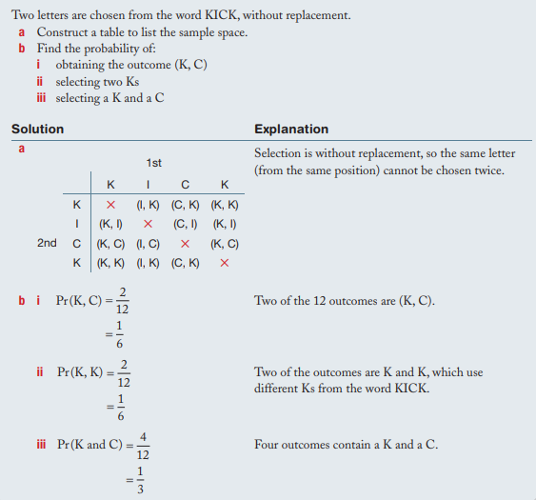
Example 3: Constructing a table without replacement
B-Grade
Not: Pr in this case is the same as P. Both are shorthand for “probability”
Notes:
Guided practice

Slide 13
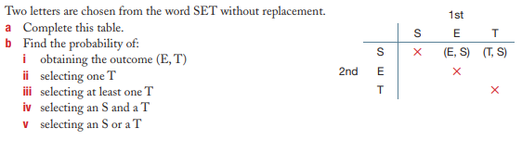
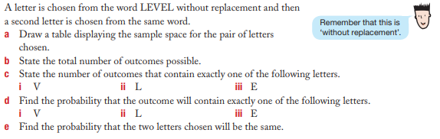
Your turn: Complete this in your Interactive notebook
Constructing two-way tables to calculate probabilities in situations that involves no replacement
1.
2.

